Slide 1
Information Security
System Security
Dr. Nguyen Khanh Van
Dept. of Software Engineering
Hanoi University of Technology
August, 2009
Information Security
Van Nguyen -- HUT
Slide #1-<number>

Slide 2
Agenda
How to approach designing the security of a computing system
Vulnerability analysis
Auditing
Security design patterns
An work-on example

Slide 3
A brief review of the study so far
We first looked at the mission and work of the field of Information Security as a whole
We then have studied a lot of different things in Security:
  Technical foundations and controls: encryption, key management, authentication, access control…
  Areas in computing applications: security problems in Networks/Programs/Web/Databases
  Many real systems: Unix, SSL, Kerberos …

Slide 4
To deal with the whole system
We now should re-look at the whole problem: How to make secure a given system as a whole
  The system can be any of:
    a software/hardware system (or both)
    a corporate intranet
    a database: online or traditional
    an operating system
    …
  Or combination of a few of them

Slide 5
The master plan
We should be able to set up a design plan with practically achievable goals then accomplish tasks:
  Analyzing security requirements
  Policies and decisions making
  Decomposing the whole thing into component problems: each component belongs to a certain area which should be well-studied
  For each component , selecting appropriate tools or architectures, refining requirements, then creating and implementing a good solution.
  Combining subsystems into the whole
  Tuning things so that all system works well together
  Documentation & maintenance process

Slide 6
Security requirements
Where to find and how to create:
  Some requirements can be straightforward, stated and given by the organization who runs the system as policies
  Some are deep under the surface: found only after a thorough analysis of possible vulnerabilities of the system
  Vulnerability analysis gives input to the whole task of designing a protection scheme to the given system
Vulnerability analysis should be based on
  The design, policies, specification and actual implementation of the system
  Risk analysis: to analyze what may go wrong
  Anomaly analysis: to analyze log/audit trail to find occurring of unexpected things

Slide 7
Vulnerability analysis: definitions
Vulnerability, security flaw: failure of security policies, procedures, and controls that allow a subject to commit an action that violates the security policy
  Subject is called an attacker
  Using the failure to violate the policy is exploiting the vulnerability or breaking in
November 1, 2004
Introduction to Computer Security
©2004 Matt Bishop
Slide #20-<number>

Slide 8
Penetration Testing
Testing to verify that a system satisfies certain constraints
Hypothesis stating system characteristics, environment, and state relevant to vulnerability
Result is compromised system state
Apply tests to try to move system from state in hypothesis to compromised system state
November 1, 2004
Introduction to Computer Security
©2004 Matt Bishop
Slide #20-<number>

Slide 9
Penetration Studies
Test for evaluating the strengths and effectiveness of all security controls on system
  Also called tiger team attack or red team attack
  Goal: violate site security policy
  Not a replacement for careful design, implementation, and structured testing
  Tests system in toto, once it is in place
    Includes procedural, operational controls as well as technological ones
November 1, 2004
Introduction to Computer Security
©2004 Matt Bishop
Slide #20-<number>

Slide 10
Goals
Attempt to violate specific constraints in security and/or integrity policy
  Implies metric for determining success
  Must be well-defined
Example: subsystem designed to allow owner to require others to give password before accessing file (i.e., password protect files)
  Goal: test this control
  Metric: did testers get access either without a password or by gaining unauthorized access to a password?
November 1, 2004
Introduction to Computer Security
©2004 Matt Bishop
Slide #20-<number>

Slide 11
Goals
Find some number of vulnerabilities, or vulnerabilities within a period of time
  If vulnerabilities categorized and studied, can draw conclusions about care taken in design, implementation, and operation
  Otherwise, list helpful in closing holes but not more
Example: vendor gets confidential documents, 30 days later publishes them on web
  Goal: obtain access to such a file; you have 30 days
  Alternate goal: gain access to files; no time limit (a Trojan horse would give access for over 30 days)
November 1, 2004
Introduction to Computer Security
©2004 Matt Bishop
Slide #20-<number>

Slide 12
Layering of Tests
External attacker with no knowledge of system
  Locate system, learn enough to be able to access it
External attacker with access to system
  Can log in, or access network servers
  Often try to expand level of access
Internal attacker with access to system
  Testers are authorized users with restricted accounts (like ordinary users)
  Typical goal is to gain unauthorized privileges or information
November 1, 2004
Introduction to Computer Security
©2004 Matt Bishop
Slide #20-<number>

Slide 13
Layering of Tests (con’t)
Studies conducted from attacker’s point of view
Environment is that in which attacker would function
If information about a particular layer irrelevant, layer can be skipped
  Example: penetration testing during design, development skips layer 1
  Example: penetration test on system with guest account usually skips layer 2
November 1, 2004
Introduction to Computer Security
©2004 Matt Bishop
Slide #20-<number>

Slide 14
Methodology
Usefulness of penetration study comes from documentation, conclusions
  Indicates whether flaws are endemic or not
  It does not come from success or failure of attempted penetration
Degree of penetration’s success also a factor
  In some situations, obtaining access to unprivileged account may be less successful than obtaining access to privileged account
November 1, 2004
Introduction to Computer Security
©2004 Matt Bishop
Slide #20-<number>

Slide 15
Flaw Hypothesis Methodology
Information gathering
  Become familiar with system’s functioning
Flaw hypothesis
  Draw on knowledge to hypothesize vulnerabilities
Flaw testing
  Test them out
Flaw generalization
  Generalize vulnerability to find others like it
(maybe) Flaw elimination
  Testers eliminate the flaw (usually not included)
November 1, 2004
Introduction to Computer Security
©2004 Matt Bishop
Slide #20-<number>

Slide 16
Information Gathering
Devise model of system and/or components
  Look for discrepencies in components
  Consider interfaces among components
Need to know system well (or learn quickly!)
  Design documents, manuals help
    Unclear specifications often misinterpreted, or interpreted differently by different people
  Look at how system manages privileged users
November 1, 2004
Introduction to Computer Security
©2004 Matt Bishop
Slide #20-<number>

Slide 17
Flaw Hypothesizing
Examine policies, procedures
  May be inconsistencies to exploit
  May be consistent, but inconsistent with design or implementation
  May not be followed
Examine implementations
  Use models of vulnerabilities to help locate potential problems
  Use manuals; try exceeding limits and restrictions; try omitting steps in procedures
November 1, 2004
Introduction to Computer Security
©2004 Matt Bishop
Slide #20-<number>

Slide 18
Flaw Hypothesizing (con’t)
Identify structures, mechanisms controlling system
  These are what attackers will use
  Environment in which they work, and were built, may have introduced errors
Throughout, draw on knowledge of other systems with similarities
  Which means they may have similar vulnerabilities
Result is list of possible flaws
November 1, 2004
Introduction to Computer Security
©2004 Matt Bishop
Slide #20-<number>

Slide 19
Flaw Testing
Figure out order to test potential flaws
  Priority is function of goals
    Example: to find major design or implementation problems, focus on potential system critical flaws
    Example: to find vulnerability to outside attackers, focus on external access protocols and programs
Figure out how to test potential flaws
  Best way: demonstrate from the analysis
    Common when flaw arises from faulty spec, design, or operation
  Otherwise, must try to exploit it
November 1, 2004
Introduction to Computer Security
©2004 Matt Bishop
Slide #20-<number>

Slide 20
Flaw Testing (con’t)
Design test to be least intrusive as possible
  Must understand exactly why flaw might arise
Procedure
  Back up system
  Verify system configured to allow exploit
    Take notes of requirements for detecting flaw
  Verify existence of flaw
    May or may not require exploiting the flaw
    Make test as simple as possible, but success must be convincing
  Must be able to repeat test successfully
November 1, 2004
Introduction to Computer Security
©2004 Matt Bishop
Slide #20-<number>

Slide 21
Flaw Generalization
As tests succeed, classes of flaws emerge
  Example: programs read input into buffer on stack, leading to buffer overflow attack; others copy command line arguments into buffer on stack ⇒ these are vulnerable too
Sometimes two different flaws may combine for devastating attack
  Example: flaw 1 gives external attacker access to unprivileged account on system; second flaw allows any user on that system to gain full privileges ⇒ any external attacker can get full privileges
November 1, 2004
Introduction to Computer Security
©2004 Matt Bishop
Slide #20-<number>

Slide 22
Flaw Elimination
Usually not included as testers are not best folks to fix this
  Designers and implementers are
Requires understanding of context, details of flaw including environment, and possibly exploit
  Design flaw uncovered during development can be corrected and parts of implementation redone
    Don’t need to know how exploit works
  Design flaw uncovered at production site may not be corrected fast enough to prevent exploitation
    So need to know how exploit works
November 1, 2004
Introduction to Computer Security
©2004 Matt Bishop
Slide #20-<number>

Slide 23
Flaw Example: fingerd
Exploited by Internet Worm of 1988
  Recurs in many places, even now
finger client send request for information to server fingerd (finger daemon)
  Request is name of at most 512 chars
  What happens if you send more?
November 1, 2004
Introduction to Computer Security
©2004 Matt Bishop
Slide #20-<number>

Slide 24
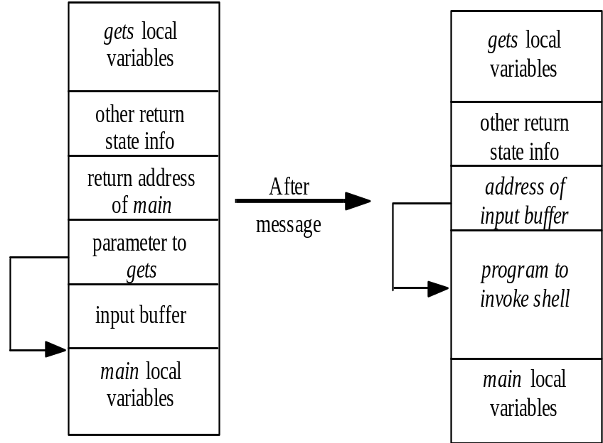
Buffer Overflow
Extra chars overwrite rest of stack, as shown
Can make those chars change return address to point to beginning of buffer
If buffer contains small program to spawn shell, attacker gets shell on target system
November 1, 2004
Introduction to Computer Security
©2004 Matt Bishop
Slide #20-<number>

Slide 25
Frameworks
Goals dictate structure of classification scheme
  Guide development of attack tool ⇒ focus is on steps needed to exploit vulnerability
  Aid software development process ⇒ focus is on design and programming errors causing vulnerabilities
Following schemes classify vulnerability as n-tuple, each element of n-tuple being classes into which vulnerability falls
  Some have 1 axis; others have multiple axes
November 1, 2004
Introduction to Computer Security
©2004 Matt Bishop
Slide #20-<number>

Slide 26
Research Into Secure Operating Systems (RISOS)
Goal: aid computer, system managers in understanding security issues in OSes, and help determine how much effort required to enhance system security
Attempted to develop methodologies and software for detecting some problems, and techniques for avoiding and ameliorating other problems
Examined Multics, TENEX, TOPS-10, GECOS, OS/MVT, SDS-940, EXEC-8
November 1, 2004
Introduction to Computer Security
©2004 Matt Bishop
Slide #20-<number>

Slide 27
Classification Scheme
Incomplete parameter validation
Inconsistent parameter validation
Imnplicit sharing f privileged/confidential data
Asynchronous validation/inadequate serialization
Inadequate identification/authentication/authorization
Violable prohibition/limit
Exploitable logic error
November 1, 2004
Introduction to Computer Security
©2004 Matt Bishop
Slide #20-<number>

Slide 28
What is Auditing?
Logging
  Recording events or statistics to provide information about system use and performance
Auditing
  Analysis of log records to present information about the system in a clear, understandable manner
November 1, 2004
Introduction to Computer Security
©2004 Matt Bishop
Slide #21-<number>

Slide 29
Uses
Describe security state
  Determine if system enters unauthorized state
Evaluate effectiveness of protection mechanisms
  Determine which mechanisms are appropriate and working
  Deter attacks because of presence of record
November 1, 2004
Introduction to Computer Security
©2004 Matt Bishop
Slide #21-<number>

Slide 30
Problems
What do you log?
  Hint: looking for violations of a policy, so record at least what will show such violations
What do you audit?
  Need not audit everything
  Key: what is the policy involved?
November 1, 2004
Introduction to Computer Security
©2004 Matt Bishop
Slide #21-<number>

Slide 31
Audit System Structure
Logger
  Records information, usually controlled by parameters
Analyzer
  Analyzes logged information looking for something
Notifier
  Reports results of analysis
November 1, 2004
Introduction to Computer Security
©2004 Matt Bishop
Slide #21-<number>

Slide 32
Logger
Type, quantity of information recorded controlled by system or program configuration parameters
May be human readable or not
  If not, usually viewing tools supplied
  Space available, portability influence storage format
November 1, 2004
Introduction to Computer Security
©2004 Matt Bishop
Slide #21-<number>

Slide 33
Example: Windows NT
Different logs for different types of events
  System event logs record system crashes, component failures, and other system events
  Application event logs record events that applications request be recorded
  Security event log records security-critical events such as logging in and out, system file accesses, and other events
Logs are binary; use event viewer to see them
If log full, can have system shut down, logging disabled, or logs overwritten
November 1, 2004
Introduction to Computer Security
©2004 Matt Bishop
Slide #21-<number>

Slide 34
Windows NT Sample Entry
Date: 2/12/2000 Source: Security
Time: 13:03 Category: Detailed Tracking
Type: Success EventID: 592
User: WINDSOR\Administrator
Computer: WINDSOR
Description:
A new process has been created:
New Process ID: 2216594592
Image File Name:
\Program Files\Internet Explorer\IEXPLORE.EXE
Creator Process ID: 2217918496
User Name: Administrator
FDomain: WINDSOR
Logon ID: (0x0,0x14B4c4)
[would be in graphical format]
November 1, 2004
Introduction to Computer Security
©2004 Matt Bishop
Slide #21-<number>

Slide 35
Design Patterns
Christopher Alexander
  “Timeless Way of Building”& “Pattern Language”
Pattern definition
  "Each pattern describes a problem which occurs over and over again in our environment, and then describes the core of the solution to that problem, in such a way that you can use this solution a million times over, without ever doing it the same way twice," Alexander

Slide 36
Design Patterns
Gang of Four “Design Patterns”
  Defined three pattern types
    Creational
    Structural
    Behavioral
Basic Pattern Template
  Problem, Context, Solution

Slide 37
Security Design Patterns
Derived from Solutions to Mis-Use Cases and Threat models
Encompass “prevention, detection, and response” (Schneier, “Secrets and Lies”)
Context and pattern relationships equally important as individual problems and solutions

Slide 38
Input Validator Pattern
Context: distributed applications are typically built to be client independent.
Problem: a minimum of assumptions and control of client interface creates possibility of malicious input. Malicious input can be used to gain unauthorized access to system processes and resources

Slide 39
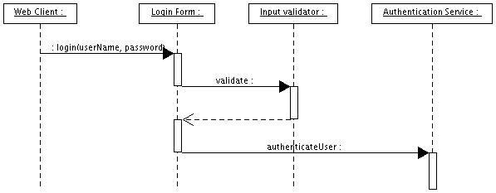
Input Validator Pattern
Solution: Do not trust input. Validate input against acceptable value criteria.

Slide 40
Improving The Solution with AOP
Aspect Oriented Programming Basics
  AOP and OOP collaborate
  Ability to address cross cutting concerns (like security!) in a modular way
  Component Relationships
  Tool Support: AspectJ, HyperJ (IBM), AspectWerks, Nanning (see www.aosd.net)
  Not Just Java

Slide 41
AOP Concepts
AspectJ Basics
  Aspect
  Join Point
    Location
  Pointcut
    Context gathering/assembling
  Advice
  Introduction

Slide 42
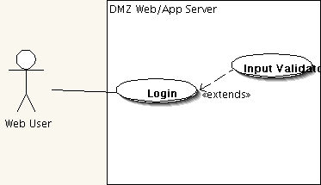
Refactoring with AspectJ
Login Use Case

Slide 43
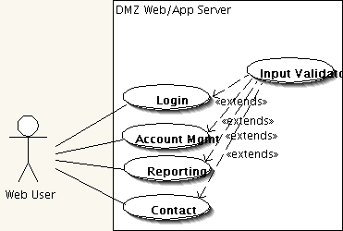
Refactoring with AspectJ
Additional Use Cases

Slide 44
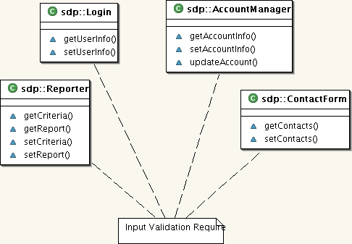
Refactoring with AspectJ
Classes with Getters

Slide 45
Work-on Example
Study the security design of a popular practical system
An on-line student records system
  Enrolment
  Academic records
  Study Progress
  Financial records

Slide 46
Review of the system design
  Online services
    Student Info
    Enrolment
    Study/Finance Records viewers
    …
  Offline work
  Client-Server

Slide 47
Security requirement analysis
Risk analysis
Possible attacks
Hacker motives

Slide 48
Look for known solutions/tools
Decomposing the system into areas
  Network/web
  Databases
  Operating systems (Access Control)
  Software programs
Applying appropriate tools/ techniques
  Encryption
  Key management
  Access controls
  Authentication

Slide 49
This set of slides is still quite open, to be added expectedly

